Slide 1

Amazon CloudFront

Slide 2
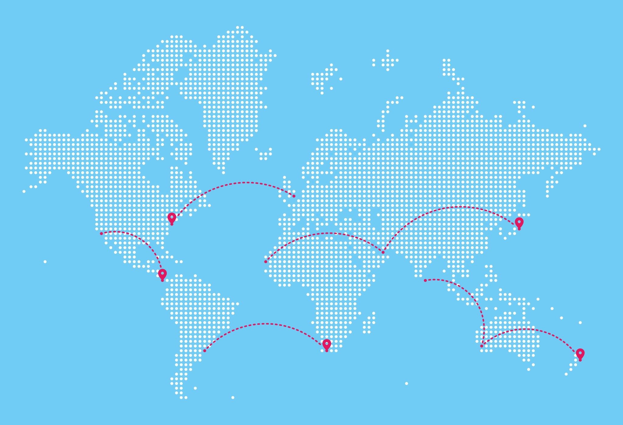
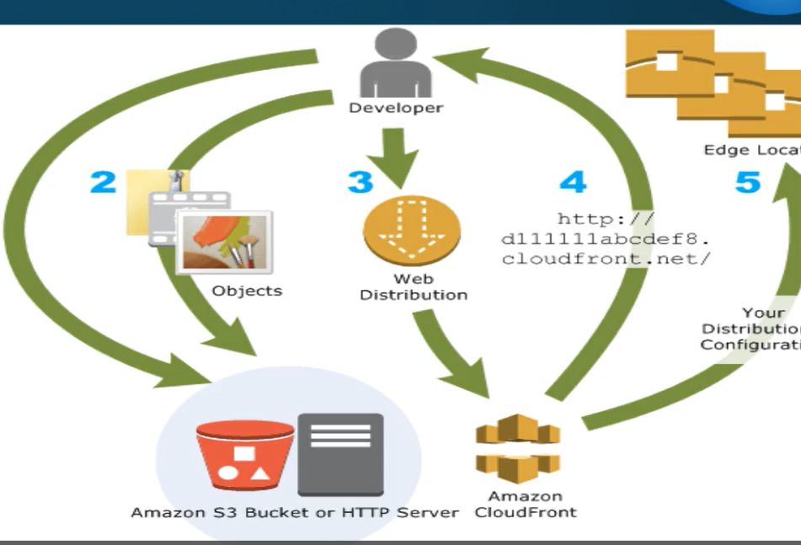
Overview
Amazon CloudFront is a Content Delivery Network (CDN) service by AWS.
It speeds up the delivery of both static (HTML, CSS, JS, images) and dynamic (API, video, live data) content to users globally.
CloudFront uses a network of Edge Locations distributed around the world to serve content closer to users.

Slide 3
Key Concepts
Term | Description
CDN (Content Delivery Network) | A global network of servers that cache and deliver web content closer to users.
Origin | The original source of content (e.g., S3 bucket, EC2 instance, on-premises server).
Edge Location | AWS data center that caches and serves content near end users.
Cache Hit | Requested content is already stored in the edge cache.
Cache Miss | Content not found in cache → fetched from origin.
TTL (Time to Live) | Duration content stays cached before refresh.

Slide 4
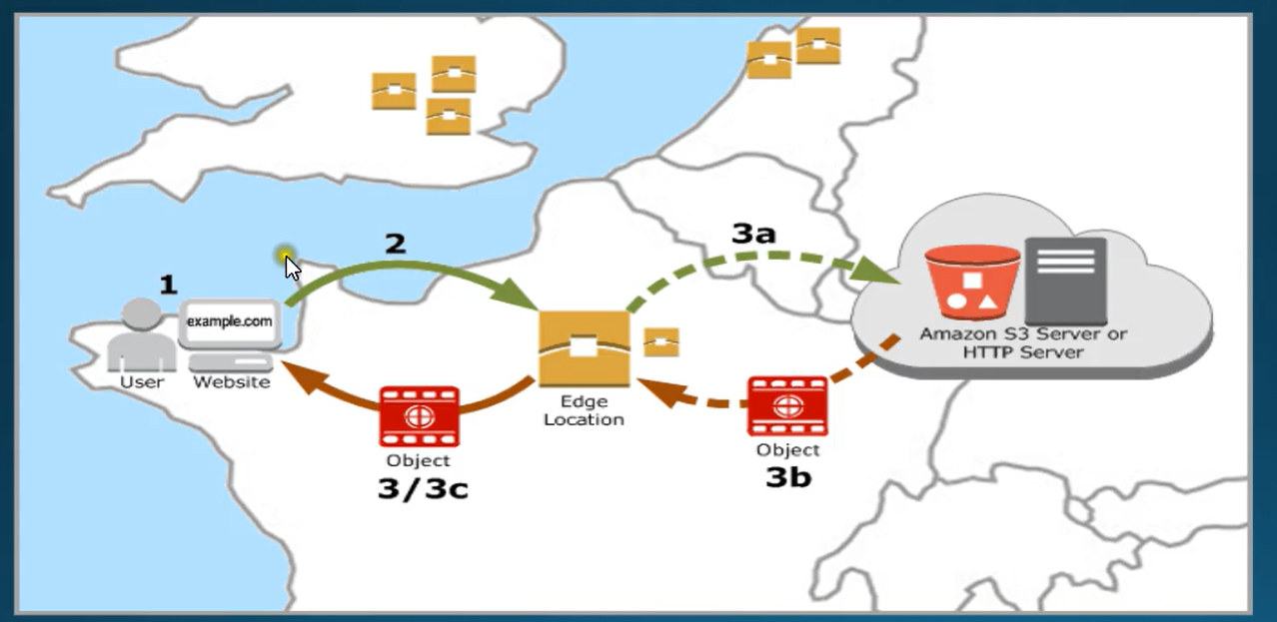
How CloudFront Works
A user requests content (e.g., image, video, API).
CloudFront routes the request to the nearest Edge Location.
If the content is cached, it’s delivered instantly (Cache Hit).
If not, CloudFront fetches it from the Origin, delivers it, and stores it in cache for future requests.
Subsequent users in that region get the content quickly from the edge cache.

Slide 5

Regional Edge Locations
Definition:
Intermediate caching layer between Edge Locations and the Origin Server in CloudFront.
Purpose:
Reduce origin load and improve cache efficiency.
Function:
Edge Location checks cache if miss request goes to Regional Edge Location.
If data found returned immediately.
If not fetched from origin, cached, and passed back.

Slide 6
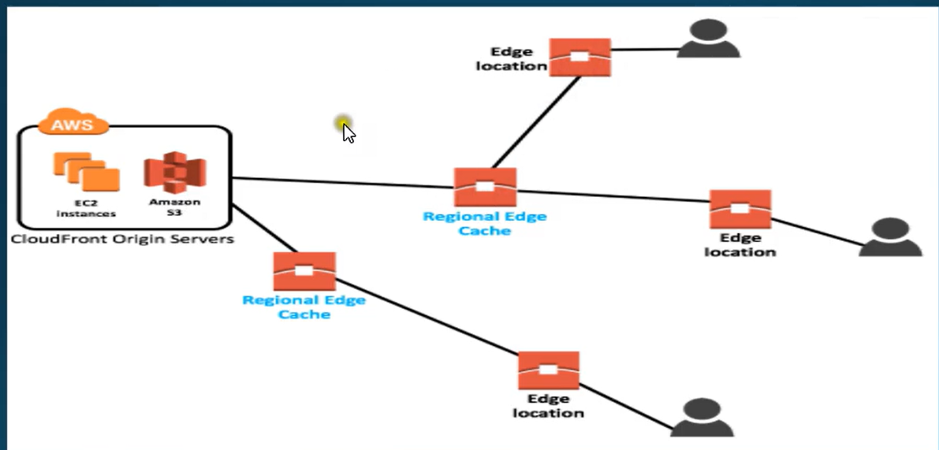
Difference from Edge Location

Slide 7
Benefits
Feature | Description
Low Latency | Content served from nearest edge location for faster response.
High Performance | Improves website and application speed globally.
Reduced Origin Load | Cached content minimizes requests to your main server.
Scalability | Automatically handles large amounts of traffic without manual scaling.
Security | Integrates with AWS Shield, WAF, and SSL/TLS for secure content delivery.
Cost Optimization | Reduces data transfer and compute costs on origin servers.

Slide 8
Common Use Cases
Hosting static and dynamic websites.
Video streaming (Live and On-Demand).
Software updates and large file downloads.
Accelerating API responses and dynamic web apps.
Serving secured content with HTTPS and signed URLs.

Slide 9
Real-World Example
Your website is hosted in the US (N. Virginia).
Users from Asia request your site.
Without CloudFront → traffic travels to the US region, slow response.
With CloudFront content is cached at Asia edge location (Singapore/India) instant load, low latency, happy users.

Slide 10
Integration
CloudFront works seamlessly with:
Amazon S3 (for static origin)
EC2 or Load Balancer (for dynamic origin)
AWS WAF & Shield (for security)
Route 53 (for DNS routing)
AWS Certificate Manager (ACM) (for SSL certificates)

